Slide 1
Introduction to Excel
Part One

Slide 2
Presentation Objectives:
Explain what Excel is.
Introduce the basic framework of Microsoft Office and Microsoft Excel in particular.
Introduce basic definitions of the components of a spreadsheet.
Develop a simple spreadsheet.

Slide 3
Excel is:
“This chapter introduces Microsoft Excel, the official number cruncher of Office 2019. The purpose of Excel is to track, analyze, and tabulate numbers.” Peter Weverka, Microsoft Office 2019, John Wiley and Sons, 2019, page 235.
“Microsoft Excel is a spreadsheet developed by Microsoft for Windows, macOS, Android and iOS. It features calculation, graphing tools, pivot tables, and a macro programming language called Visual Basic for Applications. It has been a very widely applied spreadsheet for these platforms, especially since version 5 in 1993, and it has replaced Lotus 1-2-3 as the industry standard for spreadsheets. Excel forms part of the Microsoft Office suite of software.” Wikipedia

Slide 4
Spreadsheets
A spreadsheet is a computer application for organization, analysis and storage of data in tabular form.^{[1][2][3]} Spreadsheets were developed as computerized analogs of paper accounting worksheets.^{[4]} The program operates on data entered in cells of a table. Each cell may contain either numeric or text data, or the results of formulas that automatically calculate and display a value based on the contents of other cells. A spreadsheet may also refer to one such electronic document.^{[5][6][7]}
Spreadsheet users can adjust any stored value and observe the effects on calculated values. This makes the spreadsheet useful for "what-if" analysis since many cases can be rapidly investigated without manual recalculation. Modern spreadsheet software can have multiple interacting sheets, and can display data either as text and numerals, or in graphical form.
Besides performing basic arithmetic and mathematical functions, modern spreadsheets provide built-in functions for common financial and statistical operations. Such calculations as net present value or standard deviation can be applied to tabular data with a pre-programmed function in a formula. Spreadsheet programs also provide conditional expressions, functions to convert between text and numbers, and functions that operate on strings of text.
Spreadsheets have replaced paper-based systems throughout the business world. Although they were first developed for accounting or bookkeeping tasks, they now are used extensively in any context where tabular lists are built, sorted, and shared.
Wikipedia

Slide 5
Excel Versions
There are many Excel versions

Slide 6
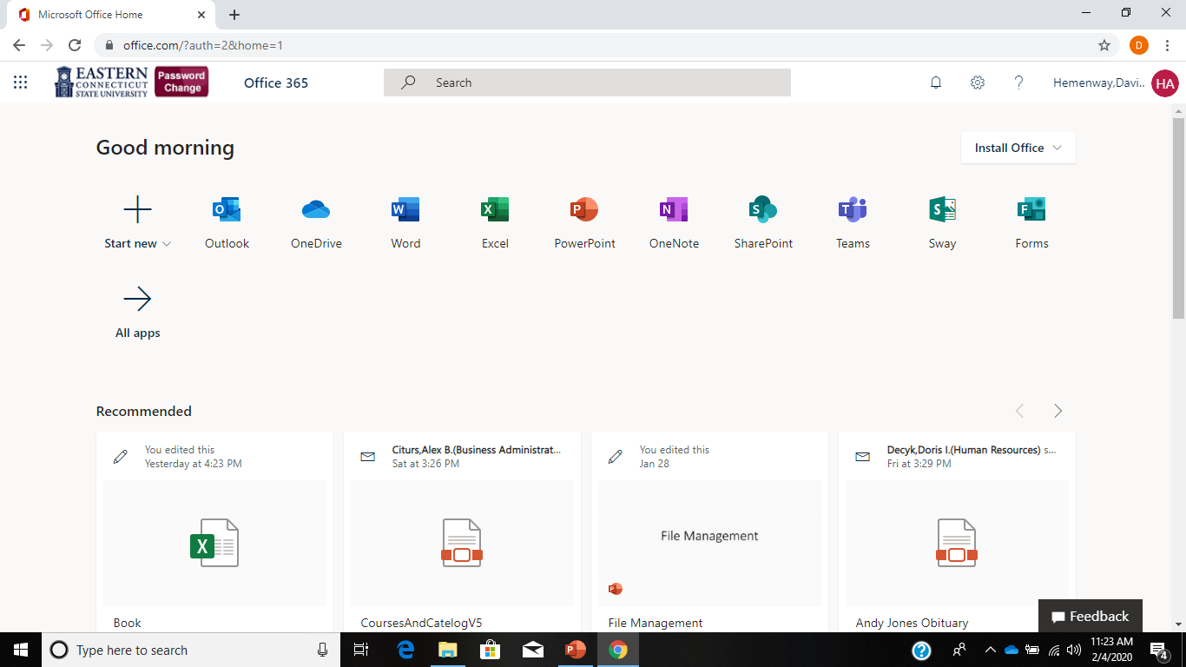
Eastern’s Microsoft 365 Page

Slide 7
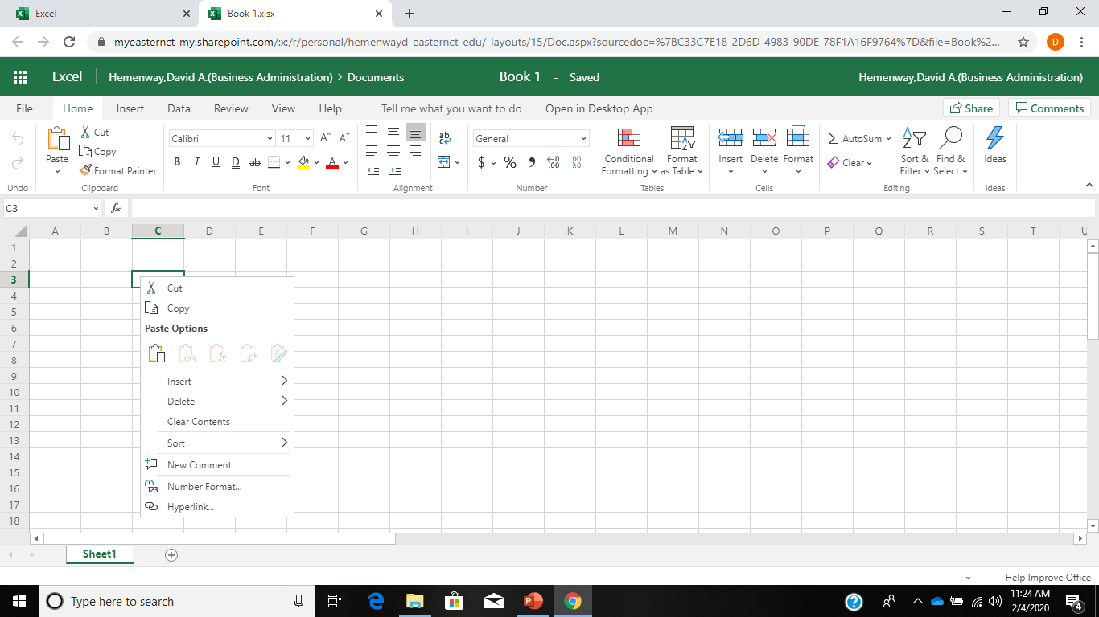
Limited Excel

Slide 8
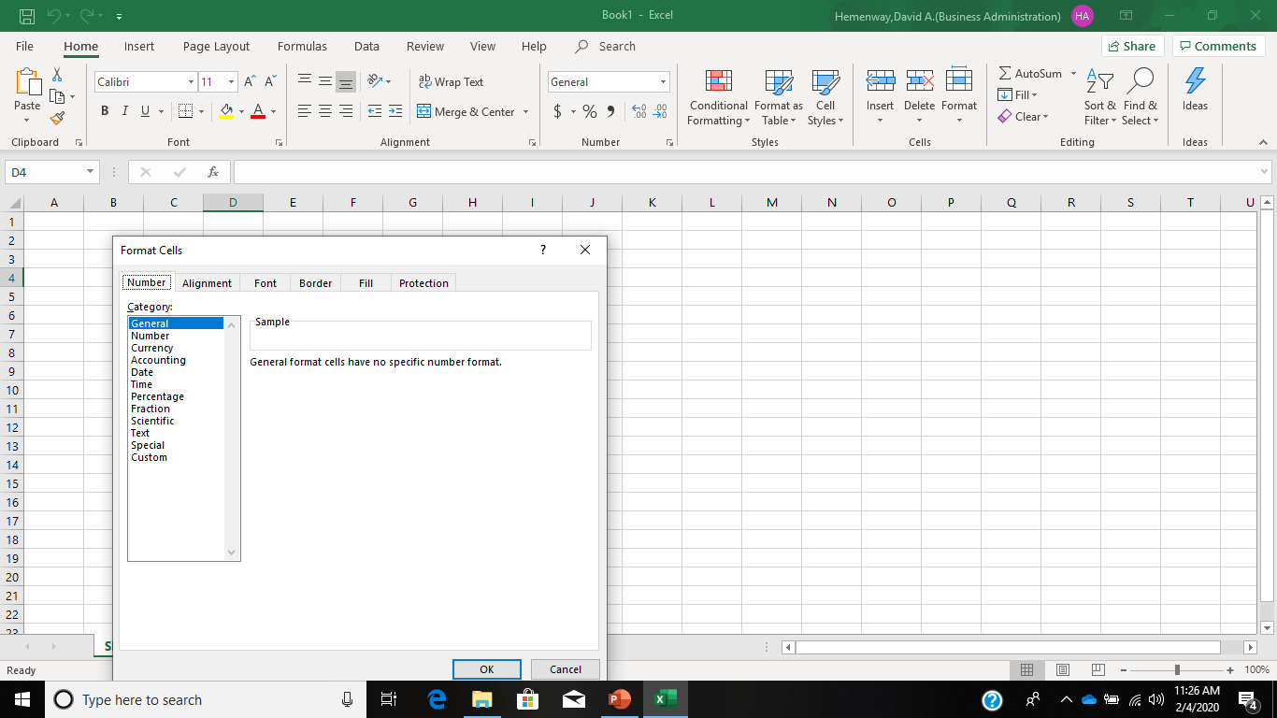
Full Excel

Slide 9
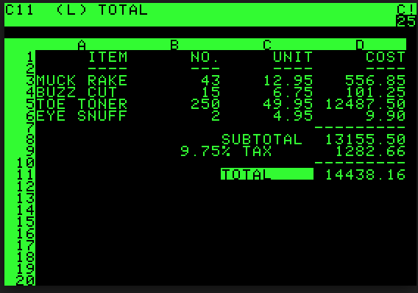
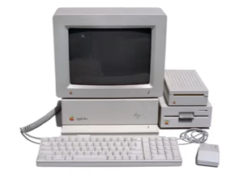
How Spreadsheets Transformed Business
Before Microsoft’s Excel came about, a Harvard MBA student and a former MIT classmate built the first spreadsheet software for the Apple II. The year was 1979
https://www.youtube.com/watch?v=ORvwzo-f1Sc

Slide 10
Excel Definitions
Workbook- An Excel file that includes one or more spreadsheets.
Sheets- The spreadsheets that comprise a workbook
Rows: The horizontal row that are represented by numbers
Columns: The vertical columns that are represented by letters
Cell Address: the intersection of a row and column that defines a cell
Calculated Cell: A formula in a cell that produces a result in a cell.
Formula: An Excel Formula that produces a calculated value.

Slide 11
Microsoft Office Definitions
Quick Access Toolbar: Upper left corner that is used to set up options in Office.
File tab and Backstage: Second row at the top of your screen is used to open/save files, printing and set other options.
The Ribbon and its Tabs: This area includes the File, Home, Insert, Page Layout, Formulas, Data, Review, View, and Help commands.
Groups and group buttons: Commands on each tab are organized into groups. The names of these groups appear below the buttons and galleries on tabs.
Buttons and galleries: This is the way you can select options under an area.
Mini-toolbars and shortcut menus: A mini-toolbar is a toolbar that appears onscreen to help you do a task. You can select an option from a drop-down list or click a button on the mini-tool bar to complete a task.
Source: Peter Weverka, Microsoft Office 2019, John Wiley and Sons, 2019, page 15

Slide 12
Excel Ribbon Explanations
Tab Name | Description of Commands
File | Also known as the Backstage view of the Excel workbook. Contains all commands for opening, closing, saving, and creating new Excel workbooks. Includes print commands, document properties, e-mailing options, and help features. The default settings and options are also found in this tab.
Home | Contains the most frequently used Excel commands. Formatting commands are found in this tab along with commands for cutting, copying, pasting, and for inserting and deleting rows and columns.
Insert | Used to insert objects such as charts, pictures, shapes, Pivot Tables, Internet links, symbols, or text boxes.
Page Layout | Contains commands used to prepare a worksheet for printing. Also includes commands used to show and print the gridlines on a worksheet.
Formulas | Includes commands for adding mathematical functions to a worksheet. Also contains tools for auditing mathematical formulas.
Data | Used when working with external data sources such as Microsoft Access, text files, or the Internet. Also contains sorting commands and access to scenario tools.
Review | Includes Spelling and Track Changes features. Also contains protection features to password protect worksheets or workbooks.
View | Used to adjust the visual appearance of a workbook. Common commands include Zoom and Page Layout view.
Help | Where you can find help for using Excel.
Search | Where you can search Excel for a topic.
Source: | Brown, Lave, Romey, Schatz, and Shingledecker, Beginning Excel, Open Oregon Educational Resources, 2017, page 10 with modifications by Dave Hemenway

Slide 13
Collapsing and Showing the Ribbon
Use these techniques to collapse the Ribbon:
Click the Collapse the Ribbon button (located to the right of the Ribbon)
Press Ctrl + F1
Right-click a tab on the Ribbon and select Collapse the Ribbon on the shortcut menu
Click the Ribbon Display options button and choose Show Tabs
Use these techniques to Show the Ribbon when it is collapsed:
Click a tab to display the Ribbon and then click the Pin the Ribbon button
Press Ctrl + F1
Right-click a tab and deselect Collapse the Ribbon
Click the Ribbon Display options button and choose Show Tabs and Commands
Source: Peter Weverka, Microsoft Office 2019, John Wiley and Sons, 2019, page 13

Slide 14
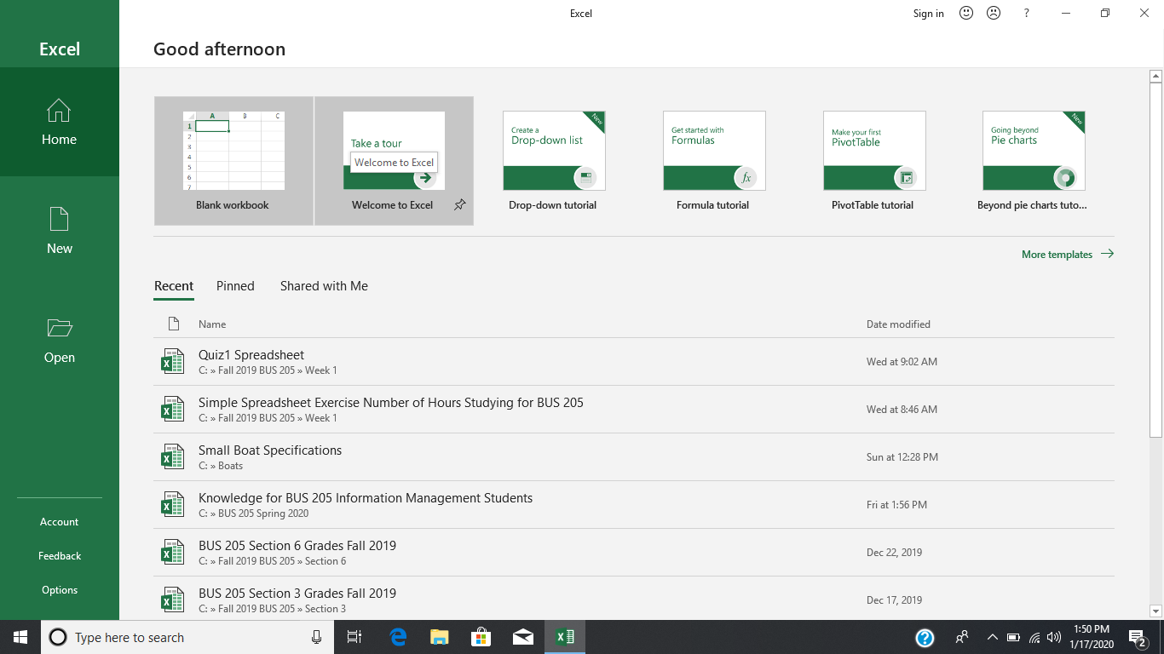
First Slide

Slide 15
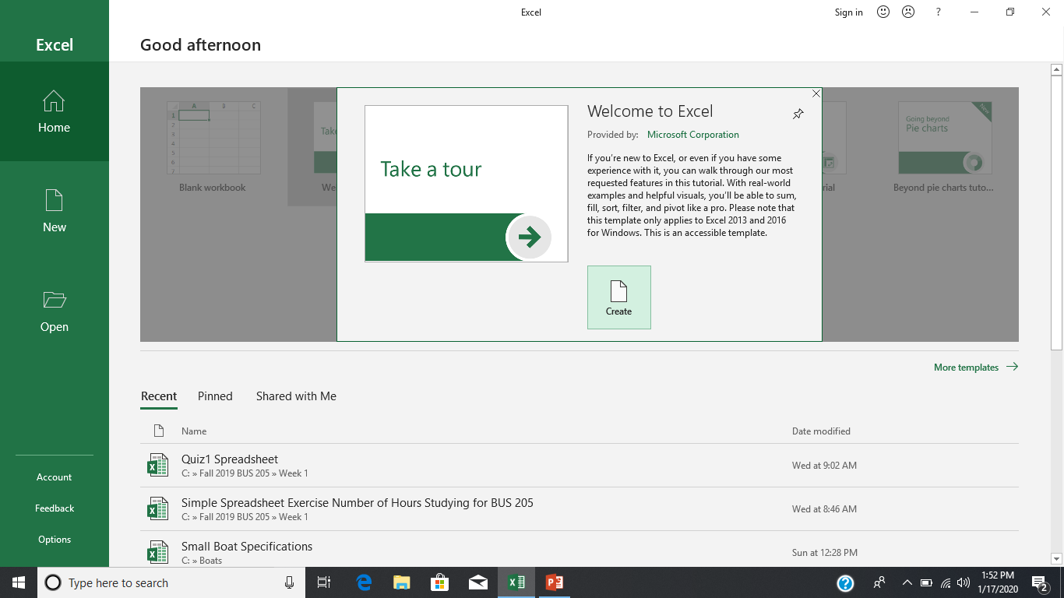
Second Slide

Slide 16
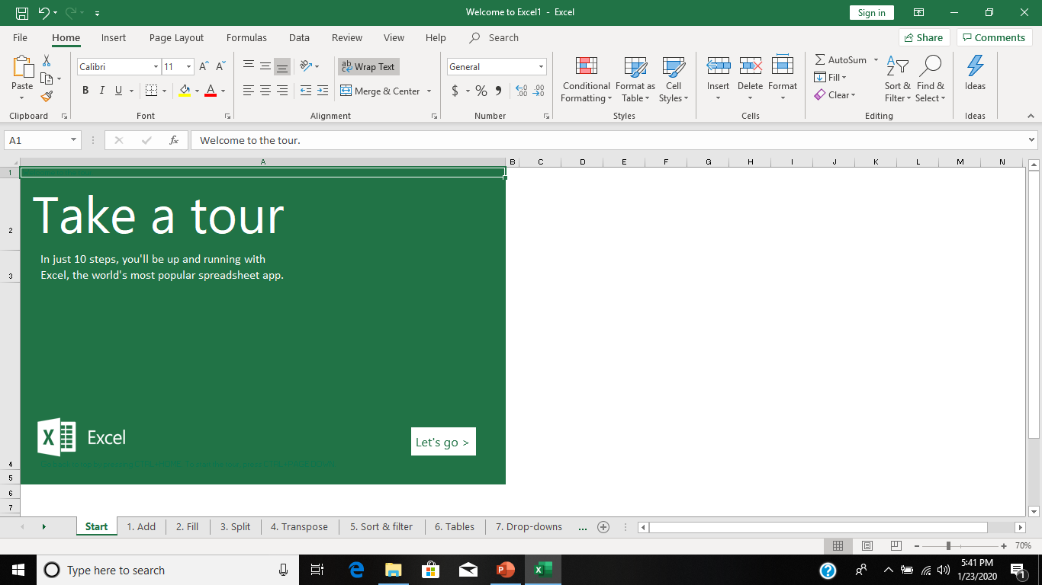
Third Slide

Slide 17
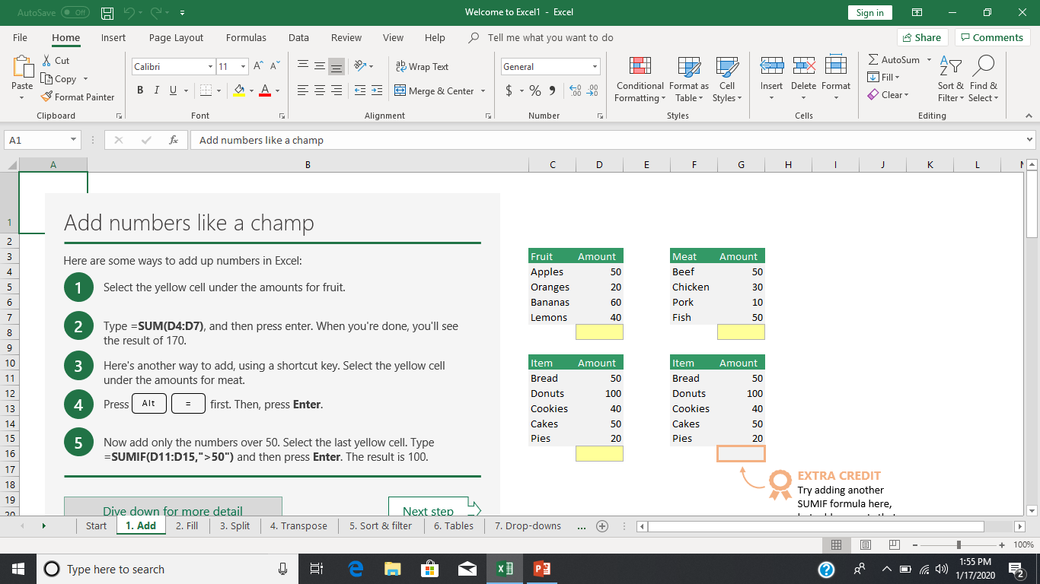
Fourth Slide

Slide 18
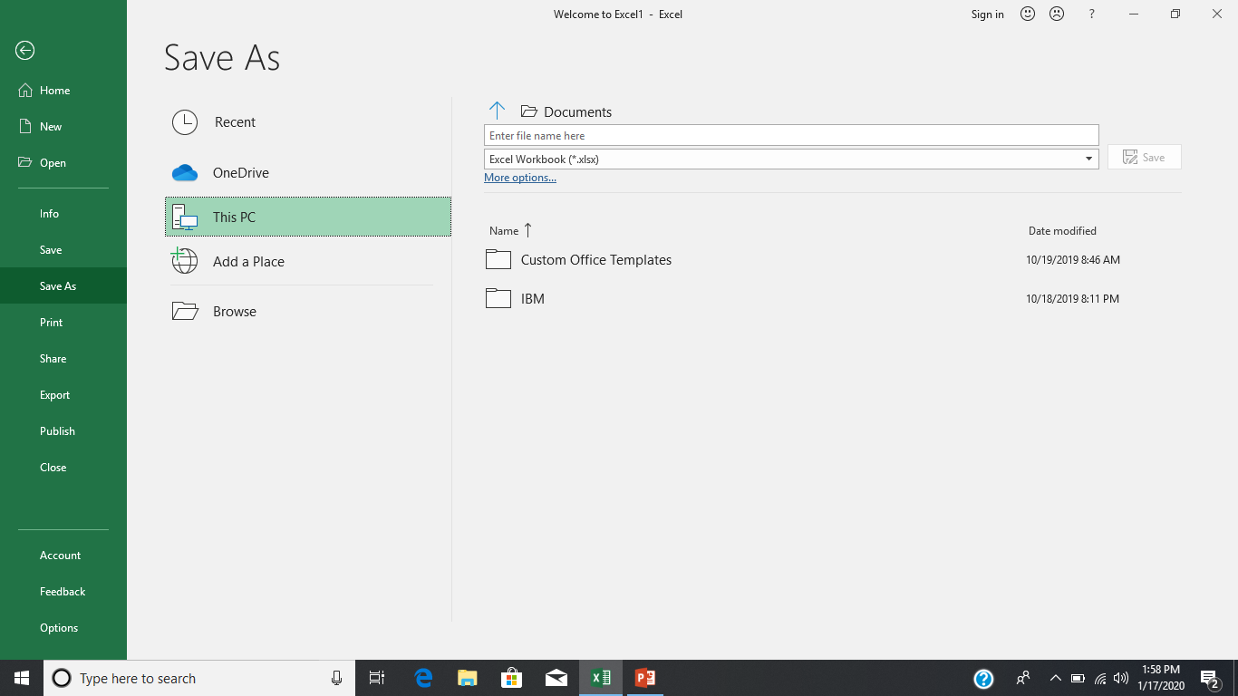
Fifth Slide

Slide 19
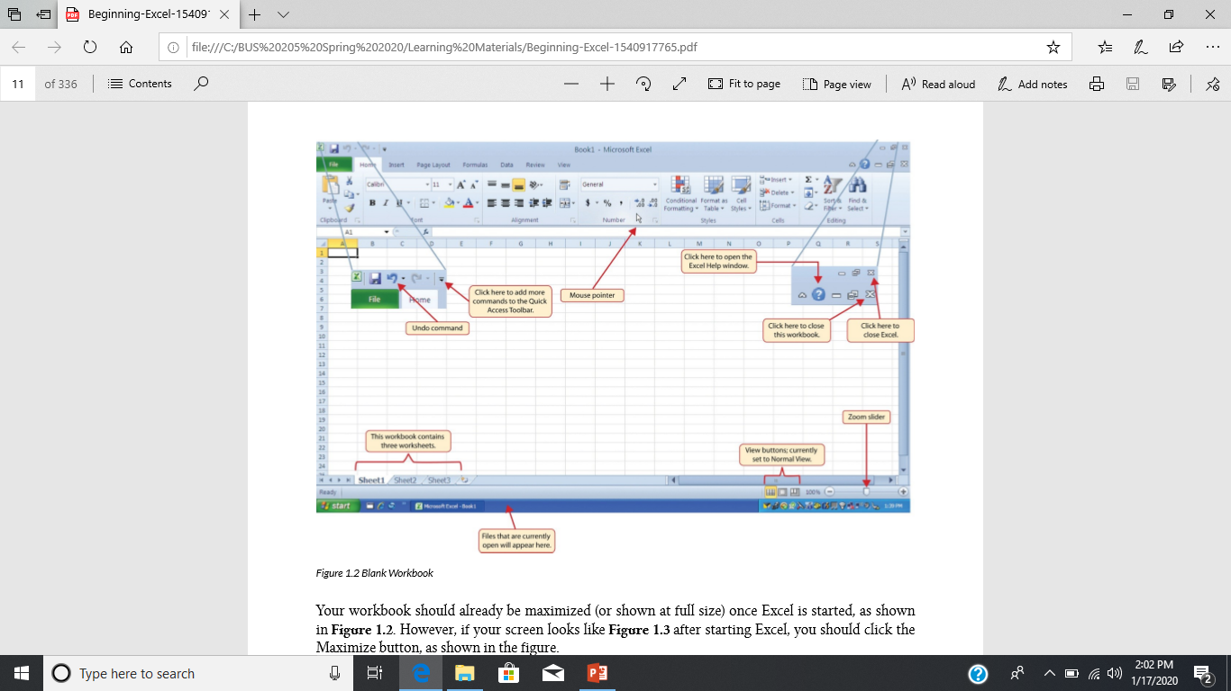
Sixth Slide

Slide 20
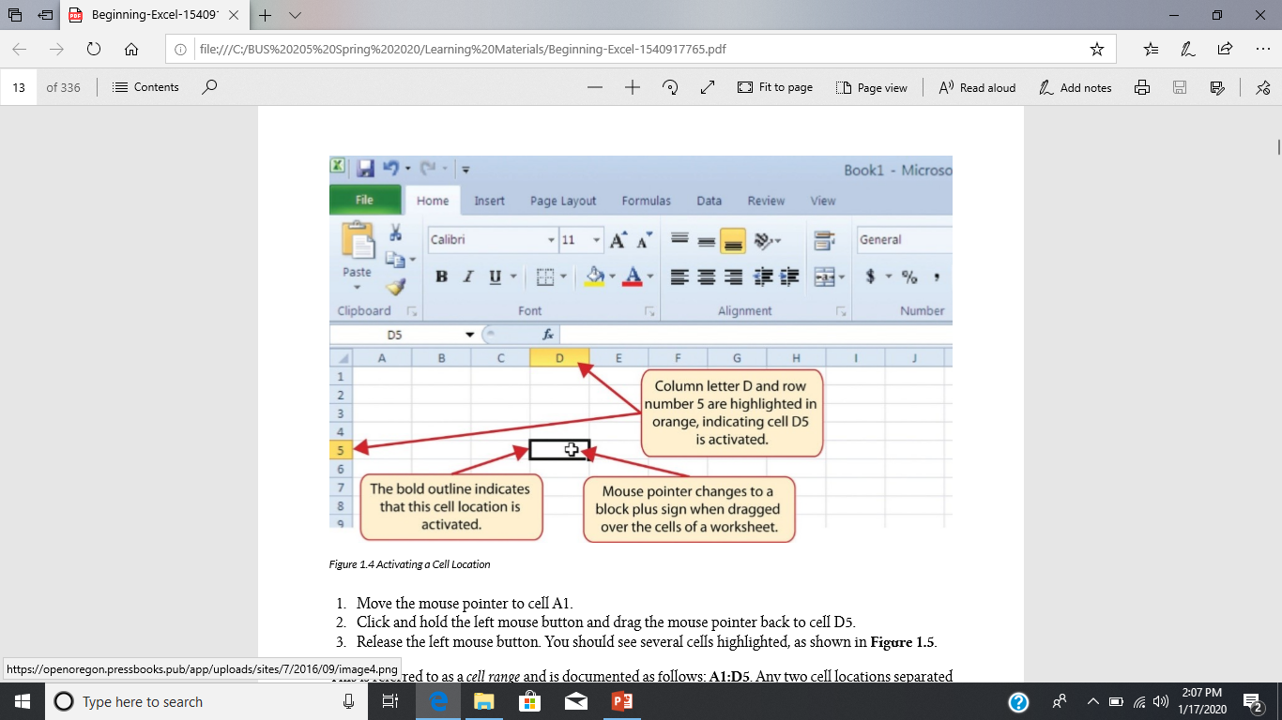
Seventh Slide

Slide 21
Assignment: Create this spreadsheet using appropriate calculations and following the shown format
ECSU BIS 205 Bookstore
 |  |  | Total
Description | Quantity | Price | Cost
Office Book | 1 | $250.00 | $250.00
MIS Book | 1 | $100.00 | $100.00
Heavy Duty Book Bag | 1 | $49.95 | $49.95
New Computer | 1 | $679.00 | $679.00
Binder for Class Project | 1 | $1.56 | $1.56
Pointer for Power Point Presentation | 1 | $9.95 | $9.95
Cushion for Long Classes | 1 | $12.50 | $12.50
Travel Mug for Caffeinated Beverage | 2 | $13.50 | $27.00
Total |  |  | $1,129.96
Source: Made-Up Data
Author:
Date:
Purpose:

Slide 22
Presentation Objectives:
Explain what Excel is.
Introduce the basic framework of Microsoft Office and Microsoft Excel in particular.
Introduce basic definitions of the components of a spreadsheet.
Develop a simple spreadsheet.

